Slide 1
7 - Kinetics and atomistic aspects of electrodeposition

Slide 2
I) Electrodeposition process: an overview
Reduction of metal ions from a solution
Metal Cation
M^{z+} +
Electrons
Deposited Metal
ze⁻
M⁰
From an ionic solution (electrolyte)
Aqueous
Organic
Molten salts
From an electronic conductor (electrode)
Metals
Semiconductors
Electrodeposit

Slide 3
I) Electrodeposition process: an overview
Reduction of metal ions from a solution
Metal Cation
M^{z+} +
Electrons
Deposited Metal
ze⁻
M⁰
From an ionic solution (electrolyte)
Aqueous
Organic
Molten salts
From an electronic conductor (electrode)
Metals
Semiconductors
Electrodeposit
Metal
e⁻
M^{z+}

Slide 4
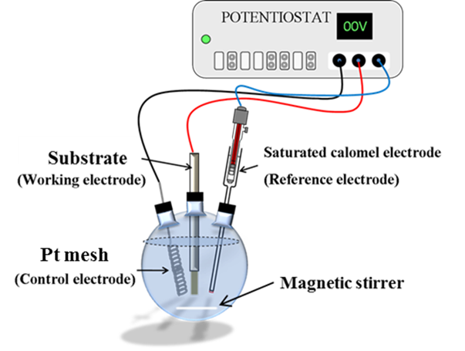
I) Electrodeposition process: an overview
Typical 3-electrodes setup
Measure the substrate potential with a reference electrode
The current passes between the working electrode (cathode) and the counter electrode (anode)

Slide 5
I) Electrodeposition process: an overview
Typical 3-electrodes setup
Measure the substrate potential with a reference electrode
The current passes between the working electrode (cathode) and the counter electrode (anode)
Electrode-electrolyte interface (double layer)
Charge transfer and mass transfer
Atomistic aspects of electrocrystallization
Nucleation and growth
Structure and properties of deposits

Slide 6
II) Metals and metallic surfaces
Metal M: definition
A lattice of cations M^{z+} in a cloud of free electrons
+
+
+
+
+
+
+
+
-
-
-
-
-
-
-
+
+
+
+
+
+
+
+
-
-
-
-
-
-
-
+
+
+
+
+
+
+
+
-
-
-
-
-
-
-
+
+
+
+
+
+
+
+
Only valence electrons contribute to the electronic cloud
Valence electrons are free of movements
Metal bonds: interaction of all valence electrons with all cations

Slide 7
II) Metals and metallic surfaces
Metal M: Defects
A lattice of cations M^{z+} in a cloud of free electrons
+
+
+
+
+
+
+
+
-
-
-
-
-
-
-
+
+
+
+
+
+
+
+
-
-
-
-
-
-
-
+
+
+
+
+
+
+
+
-
-
-
-
-
-
-
+
+
+
+
+
+
+
+
About 10²² atoms in 1 cm³ of metal → large number → unavoidable defects
Point defects (0D): vacancy defects, interstitial defects
Line and planar defects: dislocations, grain and twin boundaries, stacking faults

Slide 8
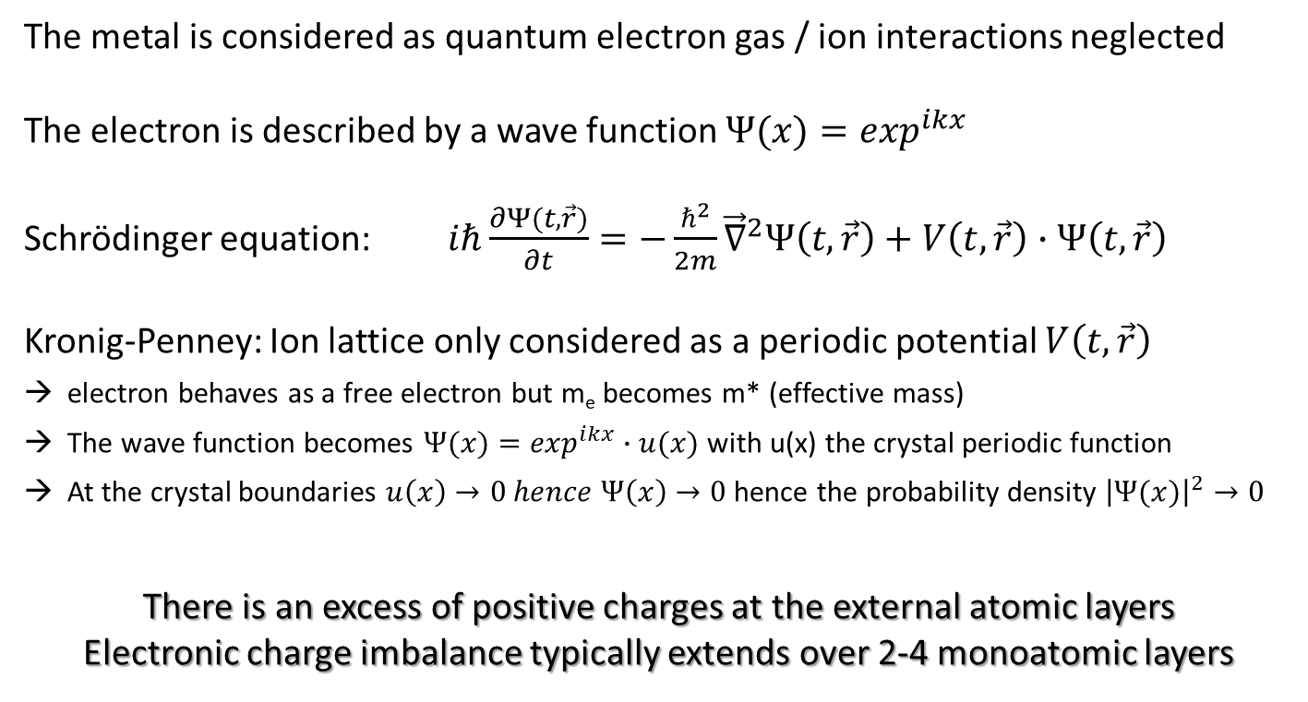
II) Metals and metallic surfaces
Sommerfeld: quantum description of the free electron
(1919)
The metal is considered as quantum electron gas / ion interactions neglected
The electron is described by a wave function $Ψ(x)=\exp^{ikx}$
Schrödinger equation: $iℏ\frac{∂Ψ(t, \vec{r})}{∂t}=−\frac{ℏ^{2}}{2m}{\vec{∇}}^{2}Ψ\left(t, \vec{r}\right)+V\left(t, \vec{r}\right)∙Ψ\left(t, \vec{r}\right)$
Kronig-Penney: Ion lattice only considered as a periodic potential $V\left(t, \vec{r}\right)$
electron behaves as a free electron but m_{e} becomes m* (effective mass)
The wave function becomes $Ψ(x)=\exp^{ikx}∙u(x)$ with u(x) the crystal periodic function
At the crystal boundaries $u\left(x\right)→0 hence Ψ\left(x\right)→0$hence the probability density ${\left|Ψ(x)\right|}^{2}→0$
There is an excess of positive charges at the external atomic layers
Electronic charge imbalance typically extends over 2-4 monoatomic layers

Slide 9
III) Metal-electrolyte interface
Surface charge development
When immersed in an electrolyte, ions and dipoles will reorganize at the interface
1) There can be spontaneous exchanges of M^{z+} between the electrode and the electrolyte
+
If M^{z+} leaving the lattice > M^{z+} bonding to the lattice
Metal develops an excess of negative charges
-
+
+
-
+
-
+
+
-
+
2) Reorientation of dipoles and redistribution of ions:
→ formation of an electrochemical double layer

Slide 10
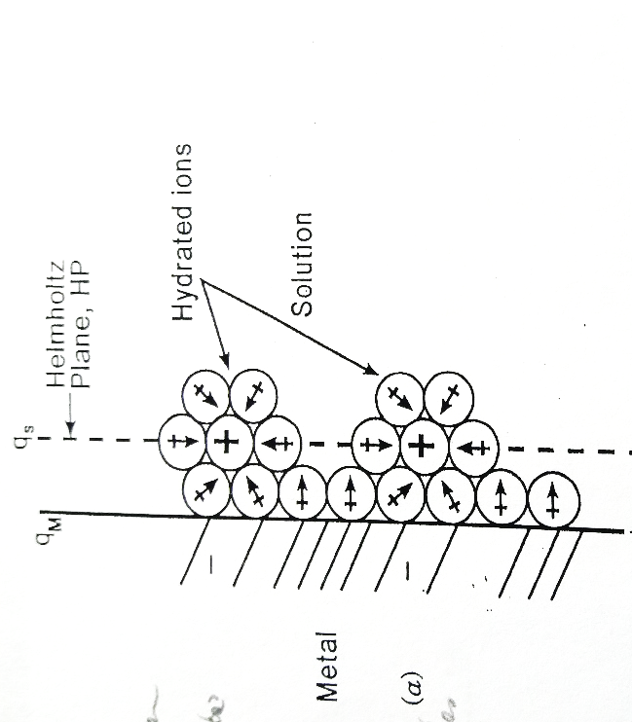
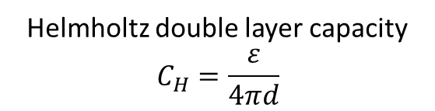
III) Metal-electrolyte interface
Helmholtz model (1879)
Positive charges are attracted
Negative charges are repulsed
Negative
metal
Positive electrolyte
Ф_{E}
Solvated ions
-
-
-
-
-
Dielectric constant ε
+
++
+
+
ΔФ
Ф_{M}
d
Helmholtz double layer capacity
$$C_{H}=\frac{ε}{4πd}$$
Problem: measured Cdl is not necessarily constant when ε and d are constant

Slide 11
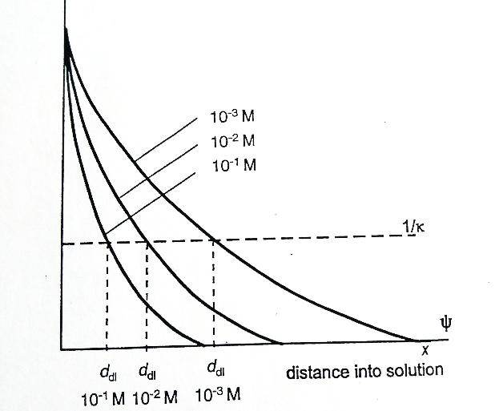

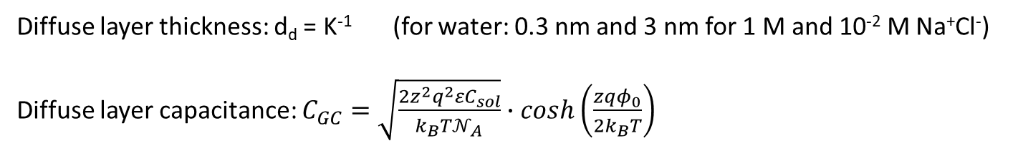

III) Metal-electrolyte interface
Gouy-Chapman model (1910-1913):
Excess charges are redistributed in the solution: diffuse layer
- Boltzman statistics and potential dependency
Ф
$$C^{+}\left(x\right)=C_{sol}^{+}∙\exp^{\frac{−zqφ\left(x\right)}{k_{B}T}}$$
$$C^{−}\left(x\right)=C_{sol}^{−}∙\exp^{\frac{zqφ(x)}{k_{B}T}}$$
$φ\left(x\right)=φ_{0}∙\exp^{−Kx}$ with $K=\sqrt{\frac{4πq^{2}}{εk_{B}T}∙\frac{C_{sol}}{𝒩_{A}}}$
Diffuse layer thickness: d_{d} = K⁻¹ (for water: 0.3 nm and 3 nm for 1 M and 10⁻² M Na⁺Cl⁻)
Diffuse layer capacitance: $C_{GC}=\sqrt{\frac{2z^{2}q^{2}{εC}_{sol}}{{k_{B}T𝒩}_{A}}}∙cosh\left(\frac{zqφ_{0}}{2k_{B}T}\right)$
Problem: works only for diluted solutions and low potentials

Slide 12
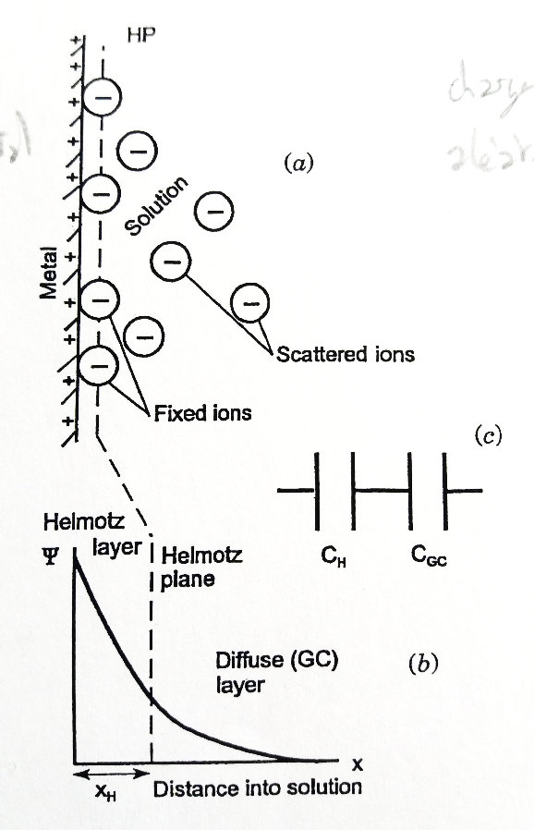
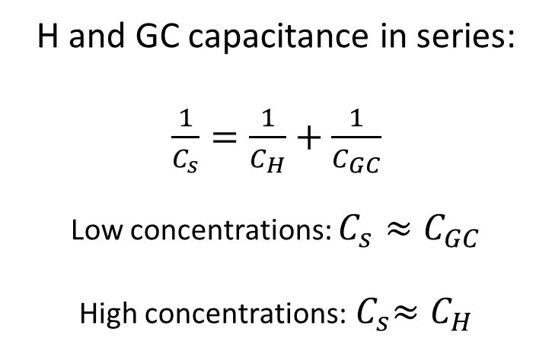
III) Metal-electrolyte interface
Stern model (1924):
Combinaison of Helmoltz and Gouy-Chapman models
H and GC capacitance in series:
$\frac{1}{C_{s}}=\frac{1}{C_{H}}+\frac{1}{C_{GC}}$
Low concentrations: $C_{s}≈C_{GC}$
High concentrations:${ C}_{s}≈C_{H}$
Ф

Slide 13
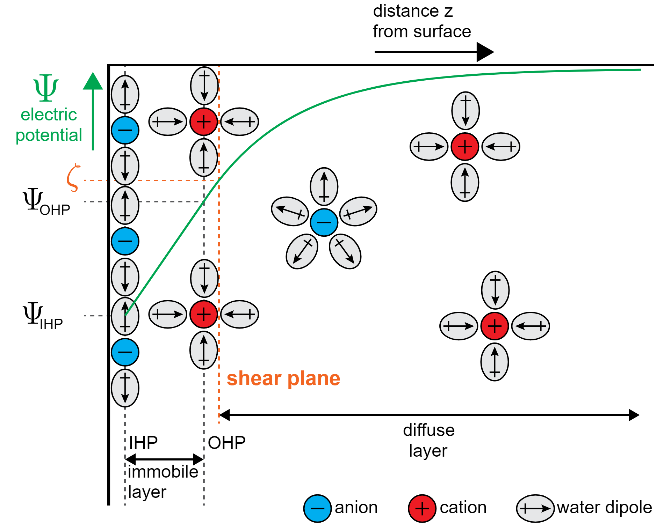
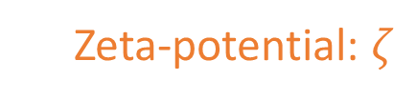
III) Metal-electrolyte interface
Grahame model (1947):
Some ions can lose their solvation sphere and specifically interact with the electrode surface: existence of immobile inner and outer Helmholtz planes
Ф
Zeta-potential: $ζ$
Ф_{OHP}
Ф_{IHP}
Determining factor for colloids
and electrophoresis

Slide 14
IV) Electrode potential
Electrode, solution, and cell potential
Direct measurements of Ф_{M} and Ф_{S} are not possible
Ф
Metal M
Ф_{Sol}
Ф_{M}
Solution

Slide 15
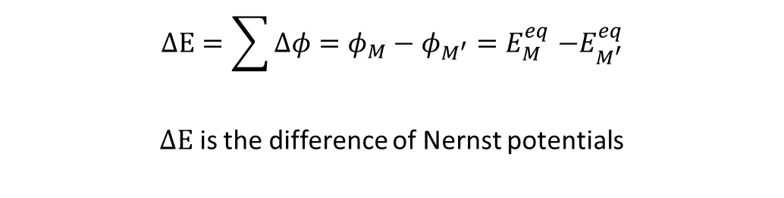
IV) Electrode potential
Electrode, solution, and cell potential
Need an additionnal electrode
V
Ф
Metal M₁
Metal M₂
Ф_{Sol}
Ф_{M}
Ф_{M’}
Solution
$$ΔΕ=\sum{Δφ}=φ_{M}−φ_{M^{′}}{=E}_{M}^{eq}−E_{M^{′}}^{eq}$$
$ΔΕ$ is the difference of Nernst potentials

Slide 16

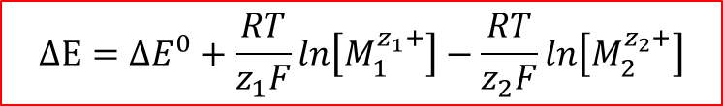
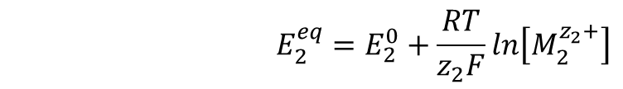
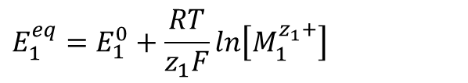

IV) Electrode potential
Electrode, solution, and cell potential
Need an additionnal electrode
V
Ф
Metal M₁
Metal M₂
Ф_{Sol}
Ф_{M}
Ф_{M’}
Solution
$M_{1}^{0}⇌M_{1}^{z_{1}+}+$ ${z_{1}e}^{−} (E_{1}^{0}$)
$$M_{2}^{0}⇌M_{2}^{z_{2}+}+{z_{2}e}^{−} (E_{2}^{0})$$
$$E_{1}^{eq}=E_{1}^{0}+\frac{RT}{z_{1}F}ln\left[M_{1}^{z_{1}+}\right]$$
$$E_{2}^{eq}=E_{2}^{0}+\frac{RT}{z_{2}F}ln\left[M_{2}^{z_{2}+}\right]$$
$$ΔΕ={ΔE}^{0}+\frac{RT}{z_{1}F}ln\left[M_{1}^{z_{1}+}\right]−\frac{RT}{z_{2}F}ln\left[M_{2}^{z_{2}+}\right]$$

Slide 17

V) Electrodeposition mechanism and kinetics
Overview
Need an additionnal electrode
V
Ф
Metal M₁
Metal M₂
Ф_{Sol}
Ф_{M}
Ф_{M’}
Solution
Let us use an electrolyte that contains solvated $M_{1}^{z_{1}+}$cations
And let us apply a $ΔE$ > ${ΔE}^{0}$ $⟺ E_{1}<E_{1}^{eq} and{ E}_{2}>E_{2}^{eq}$
Overpotential: $η_{i}=E_{i}−E_{i}^{eq}$ $⟺i≠0 A \left(electrical current\right)$
Electrodeposition at the cathode:${ M}_{1}^{z_{1}+}+$ ${z_{1}e}^{−}⇌M_{1}^{0}$

Slide 18
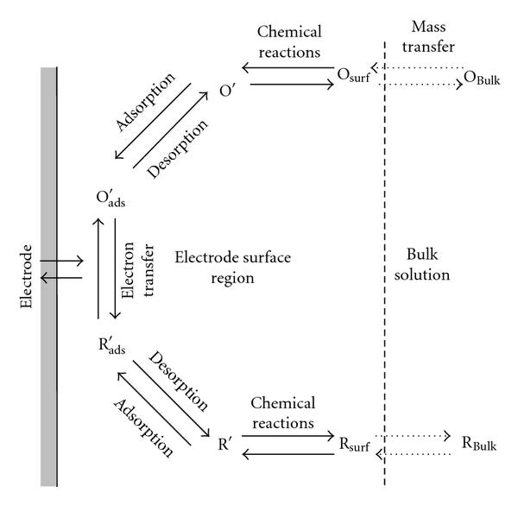
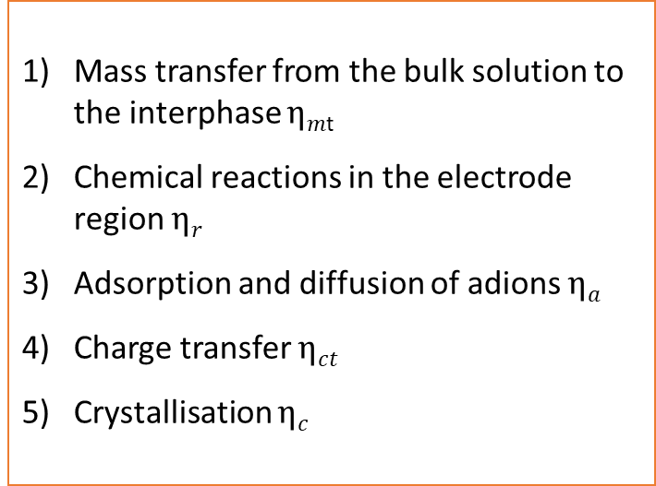
V) Electrodeposition mechanism and kinetics
Overview
Electrodeposition is governed by 5 fundamental processes
Mass transfer from the bulk solution to the interphase $ηm$_{t}
Chemical reactions in the electrode region $ηr$
Adsorption and diffusion of adions $ηa$
Charge transfer $ηct$
Crystallisation $ηc$
$$η=η_{mt}+η_{r}+η_{a}+η_{c}+η_{ct}=a+b∙\log{i}$$
Current independent
Tafel law

Slide 19



V) Electrodeposition mechanism and kinetics
1) Charge transfer: current-voltage relation
$$i_{Red}=zFk_{Red}\left[Ox\right]$$
1st order kinetics
$$i_{Ox}=zFk_{Ox}\left[Red\right]$$
where F is the Faraday constant $F=q𝒩_{A}=96485 C.{mol}^{−1}$
$k_{Red}$ and $k_{Ox}$ are kinetic constants that satisfy the Arrhenius law

Slide 20




V) Electrodeposition mechanism and kinetics
1) Charge transfer: current-voltage relation
$$i_{Red}=zFk_{Red}\left[Ox\right]$$
1st order kinetics
$$i_{Ox}=zFk_{Ox}\left[Red\right]$$
where F is the Faraday constant $F=q𝒩_{A}=96485 C.{mol}^{−1}$
$k_{Red}$ and $k_{Ox}$ are kinetic constants that satisfy the Arrhenius law
$$k_{Red}=β_{Red}∙\exp^{\frac{−∆G_{Red}^{∗}}{RT}}$$
$$k_{Ox}=β_{Ox}∙\exp^{\frac{−∆G_{Ox}^{∗}}{RT}}$$
$${∆G}_{Red}^{∗}={∆G}_{χ, Red}^{∗}+αzFΔφ$$
$${∆G}_{Ox}^{∗}={∆G}_{χ, Ox}^{∗}−(1−α)zFΔφ$$
Chemical
Potential independent
Electrochemical
Potential dependent

Slide 21
V) Electrodeposition mechanism and kinetics
1) Charge transfer: current-voltage relation
$$i_{Red}=zFk_{Red}\left[Ox\right]$$
1st order kinetics
$$i_{Ox}=zFk_{Ox}\left[Red\right]$$
where F is the Faraday constant $F=q𝒩_{A}=96485 C.{mol}^{−1}$
$k_{Red}$ and $k_{Ox}$ are kinetic constants that satisfy the Arrhenius law
$$k_{Red}=β_{Red}∙\exp^{\frac{−∆G_{Red}^{∗}}{RT}}$$
$$k_{Ox}=β_{Ox}∙\exp^{\frac{−∆G_{Ox}^{∗}}{RT}}$$
$${∆G}_{Red}^{∗}={∆G}_{χ, Red}^{∗}+αzFΔφ$$
$${∆G}_{Ox}^{∗}={∆G}_{χ, Ox}^{∗}−(1−α)zFΔφ$$

Slide 22
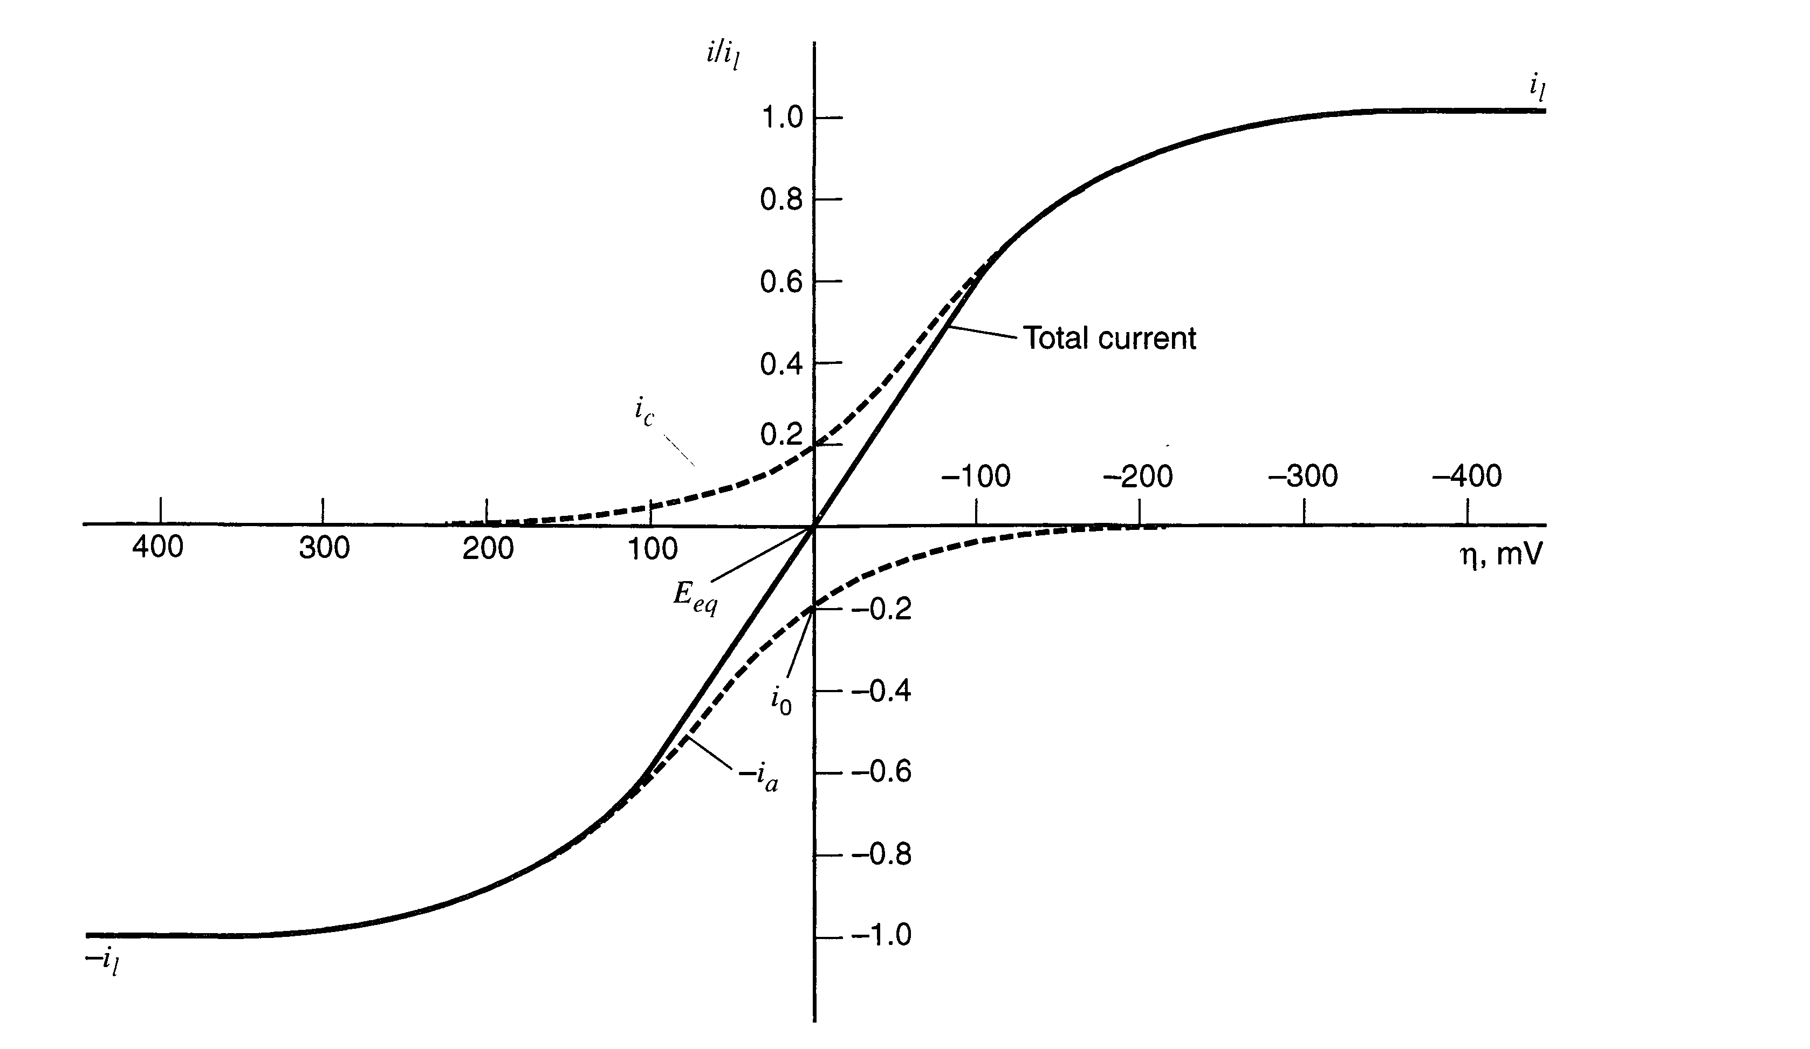

V) Electrodeposition mechanism and kinetics
1) Charge transfer: current-voltage relation
i_{Red}
-i_{Ox}
At equilibrium: $Δφ={Δφ}_{eq}$
$i_{Red}=i_{Ox}$ = i₀

Slide 23

V) Electrodeposition mechanism and kinetics
1) Charge transfer: current-voltage relation
$$i_{Red}=zFk_{Red}\left[Ox\right]$$
1st order kinetics
$$i_{Ox}=zFk_{Ox}\left[Red\right]$$
where F is the Faraday constant $F=q𝒩_{A}=96485 C.{mol}^{−1}$
At equilibrium: $Δφ={Δφ}_{eq}$
$i_{Red}=i_{Ox}$ = i₀
$zFk_{Red}\left[Ox\right]$= $zFk_{Ox}\left[Red\right]$

Slide 24
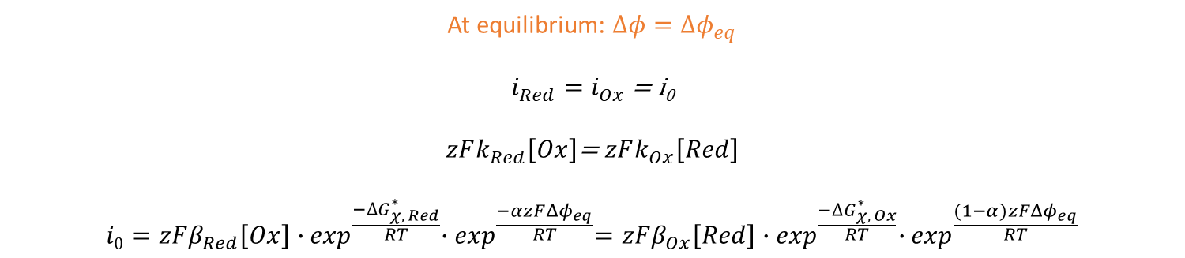
V) Electrodeposition mechanism and kinetics
1) Charge transfer: current-voltage relation
$$i_{Red}=zFk_{Red}\left[Ox\right]$$
1st order kinetics
$$i_{Ox}=zFk_{Ox}\left[Red\right]$$
where F is the Faraday constant $F=q𝒩_{A}=96485 C.{mol}^{−1}$
$k_{Red}$ and $k_{Ox}$ are kinetic constants that satisfy the Arrhenius law
$$k_{Red}=β_{Red}∙\exp^{\frac{−∆G_{Red}^{∗}}{RT}}$$
$$k_{Ox}=β_{Ox}∙\exp^{\frac{−∆G_{Ox}^{∗}}{RT}}$$
$${∆G}_{Red}^{∗}={∆G}_{χ, Red}^{∗}+αzFΔφ$$
$${∆G}_{Ox}^{∗}={∆G}_{χ, Ox}^{∗}−(1−α)zFΔφ$$
At equilibrium: $Δφ={Δφ}_{eq}$
$i_{Red}=i_{Ox}$ = i₀
$zFk_{Red}\left[Ox\right]$= $zFk_{Ox}\left[Red\right]$
$$i0=zFβ_{Red}\left[Ox\right]{∙exp}^{\frac{−∆G_{χ, Red}^{∗}}{RT}}{∙exp}^{\frac{−αzF{Δφ}_{eq}}{RT}}=zFβ_{Ox}\left[Red\right]{∙exp}^{\frac{−∆G_{χ, Ox}^{∗}}{RT}}{∙exp}^{\frac{(1−α)zF{Δφ}_{eq}}{RT}}$$
Exchange current

Slide 25

V) Electrodeposition mechanism and kinetics
1) Charge transfer: current-voltage relation
i_{Red}
-i_{Ox}
Out of equilibrium: $Δφ={Δφ}_{eq}+η$
$$i={i_{Ox}−i}_{Red}=zFk_{Ox}\left[Red\right]−zFk_{Red}\left[Ox\right]$$

Slide 26
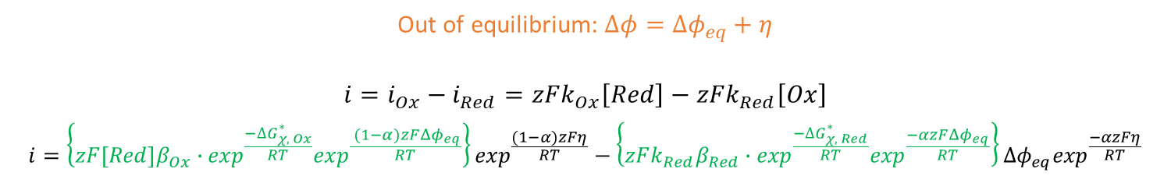
V) Electrodeposition mechanism and kinetics
1) Charge transfer: current-voltage relation
$$i_{Red}=zFk_{Red}\left[Ox\right]$$
1st order kinetics
$$i_{Ox}=zFk_{Ox}\left[Red\right]$$
where F is the Faraday constant $F=q𝒩_{A}=96485 C.{mol}^{−1}$
$k_{Red}$ and $k_{Ox}$ are kinetic constants that satisfy the Arrhenius law
$$k_{Red}=β_{Red}∙\exp^{\frac{−∆G_{Red}^{∗}}{RT}}$$
$$k_{Ox}=β_{Ox}∙\exp^{\frac{−∆G_{Ox}^{∗}}{RT}}$$
$${∆G}_{Red}^{∗}={∆G}_{χ, Red}^{∗}+αzFΔφ$$
$${∆G}_{Ox}^{∗}={∆G}_{χ, Ox}^{∗}−(1−α)zFΔφ$$
Out of equilibrium: $Δφ={Δφ}_{eq}+η$
$$i={i_{Ox}−i}_{Red}=zFk_{Ox}\left[Red\right]−zFk_{Red}\left[Ox\right]$$
$$i=\left\{zF\left[Red\right]β_{Ox}∙\exp^{\frac{{−∆G}_{χ, Ox}^{∗}}{RT}}\exp^{\frac{ (1−α)zF{Δφ}_{eq}}{RT}}\right\}\exp^{\frac{(1−α)zFη}{RT}}−\left\{zFk_{Red}β_{Red}∙\exp^{\frac{−{∆G}_{χ, Red}^{∗}}{RT}}\exp^{\frac{−αzF{Δφ}_{eq}}{RT}}\right\}{Δφ}_{eq}\exp^{\frac{−αzFη}{RT}}$$

Slide 27


V) Electrodeposition mechanism and kinetics
1) Charge transfer: current-voltage relation
$$i_{Red}=zFk_{Red}\left[Ox\right]$$
1st order kinetics
$$i_{Ox}=zFk_{Ox}\left[Red\right]$$
where F is the Faraday constant $F=q𝒩_{A}=96485 C.{mol}^{−1}$
$k_{Red}$ and $k_{Ox}$ are kinetic constants that satisfy the Arrhenius law
$$k_{Red}=β_{Red}∙\exp^{\frac{−∆G_{Red}^{∗}}{RT}}$$
$$k_{Ox}=β_{Ox}∙\exp^{\frac{−∆G_{Ox}^{∗}}{RT}}$$
$${∆G}_{Red}^{∗}={∆G}_{χ, Red}^{∗}+αzFΔφ$$
$${∆G}_{Ox}^{∗}={∆G}_{χ, Ox}^{∗}−(1−α)zFΔφ$$
Out of equilibrium: $Δφ={Δφ}_{eq}+η$
$$i={i_{Ox}−i}_{Red}=zFk_{Ox}\left[Red\right]−zFk_{Red}\left[Ox\right]$$
$$i=\left\{zF\left[Red\right]β_{Ox}∙\exp^{\frac{{−∆G}_{χ, Ox}^{∗}}{RT}}\exp^{\frac{ (1−α)zF{Δφ}_{eq}}{RT}}\right\}\exp^{\frac{(1−α)zFη}{RT}}−\left\{zFk_{Red}β_{Red}∙\exp^{\frac{−{∆G}_{χ, Red}^{∗}}{RT}}\exp^{\frac{−αzF{Δφ}_{eq}}{RT}}\right\}{Δφ}_{eq}\exp^{\frac{−αzFη}{RT}}$$
$$i=i_{0}\left(\exp^{\frac{(1−α)zFη}{RT}}−\exp^{\frac{−αzFη}{RT}}\right)$$
Butler-Volmer equation

Slide 28
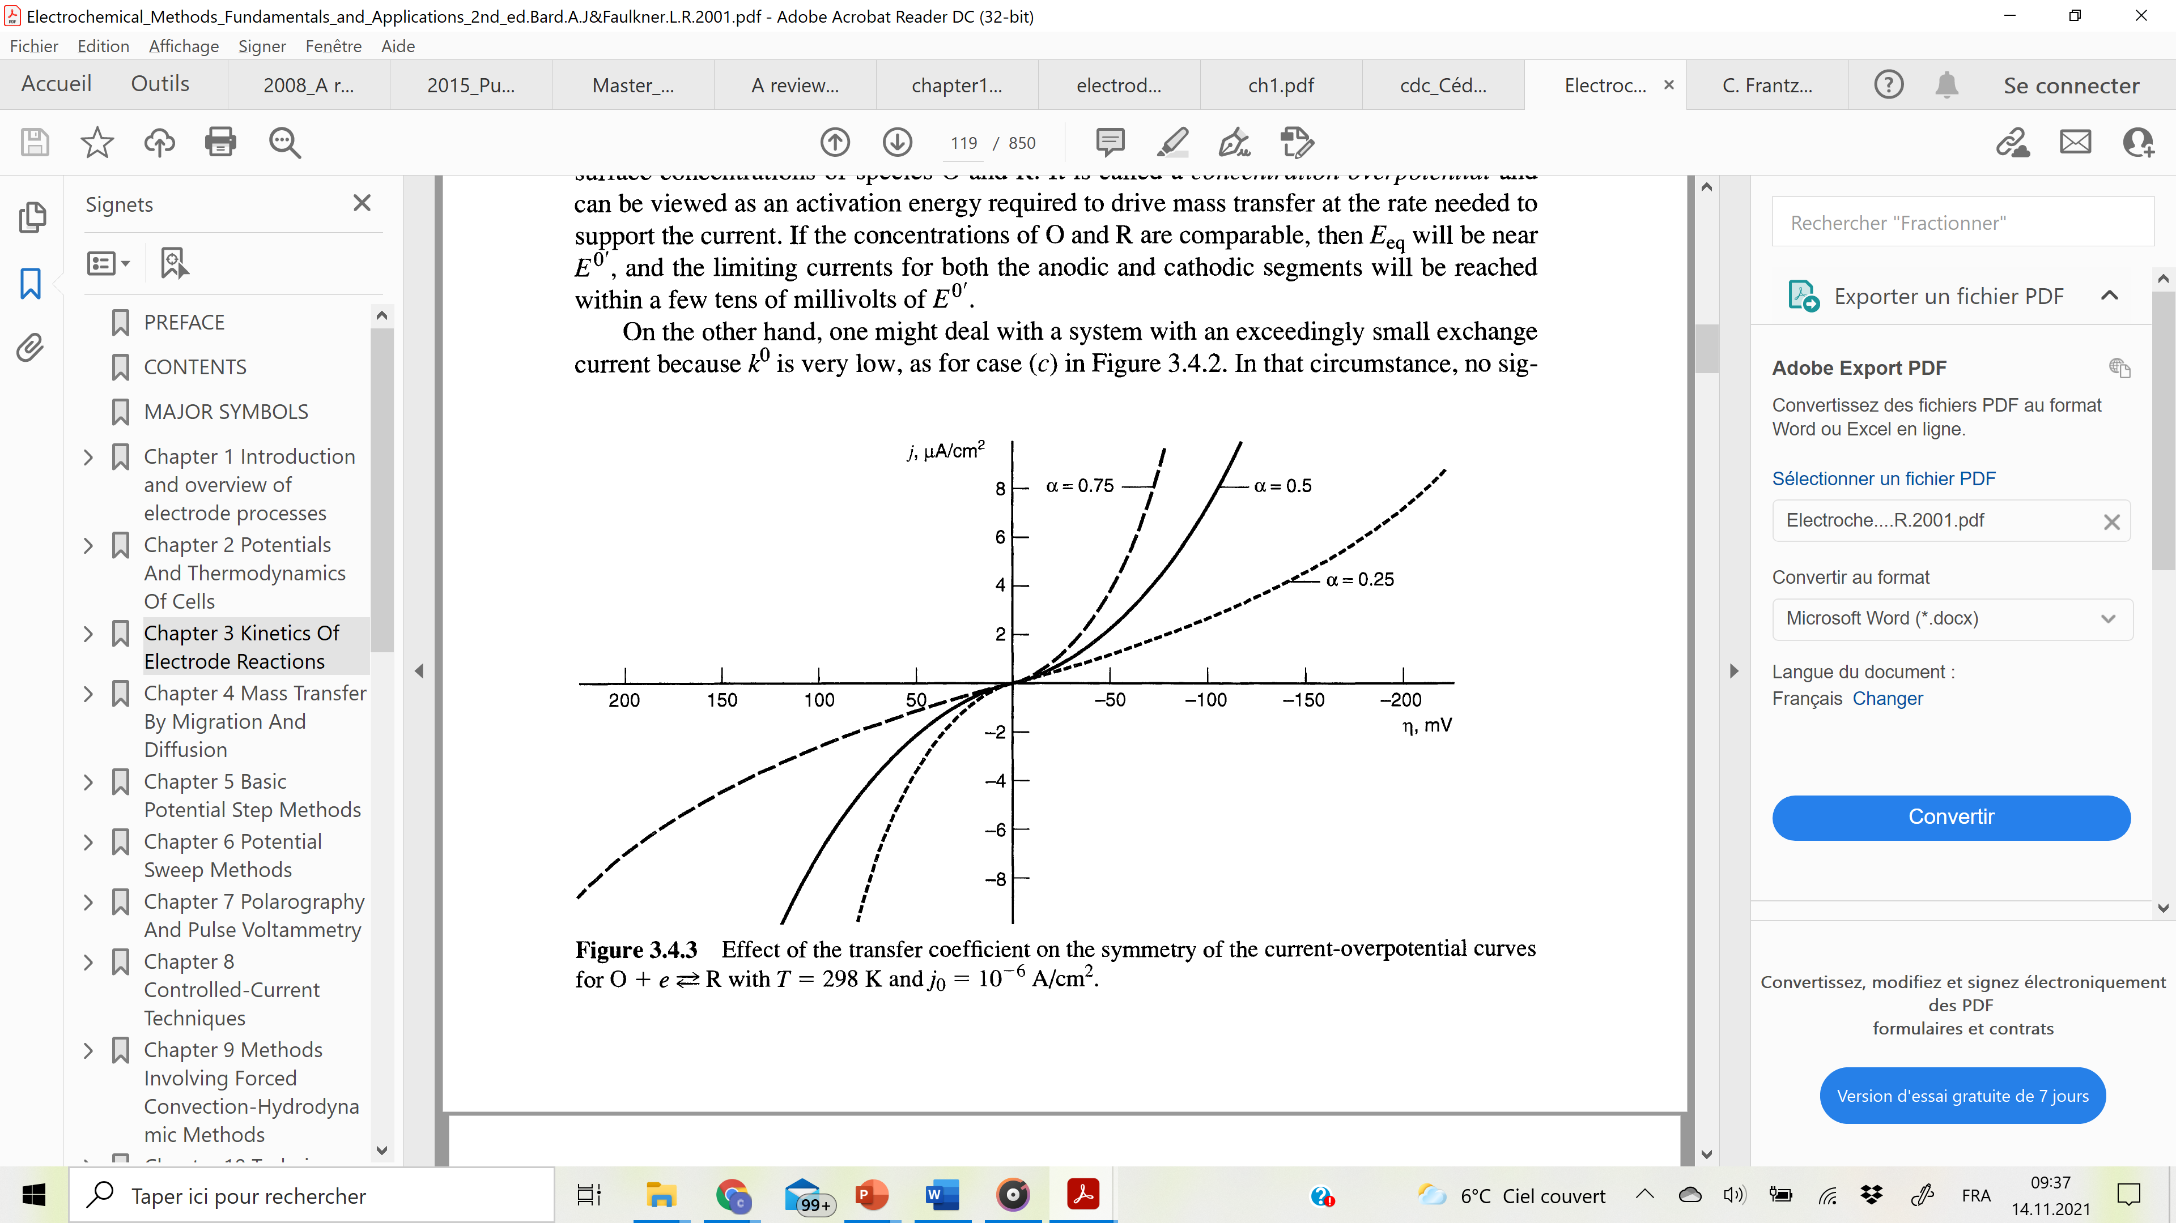
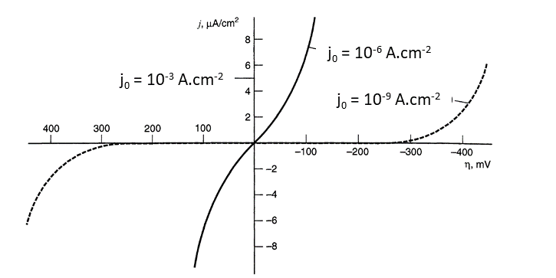
V) Electrodeposition mechanism and kinetics
1) Charge transfer: current-voltage relation
Effect of the transfer coefficient α
Effect of the exchange current i₀
$$i=i_{0}\left(\exp^{\frac{(1−α)zFη}{RT}}−\exp^{\frac{−αzFη}{RT}}\right)$$
Butler-Volmer equation

Slide 29

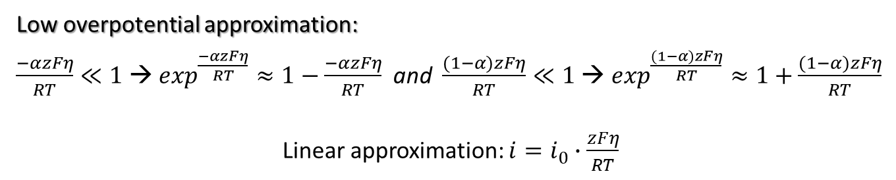
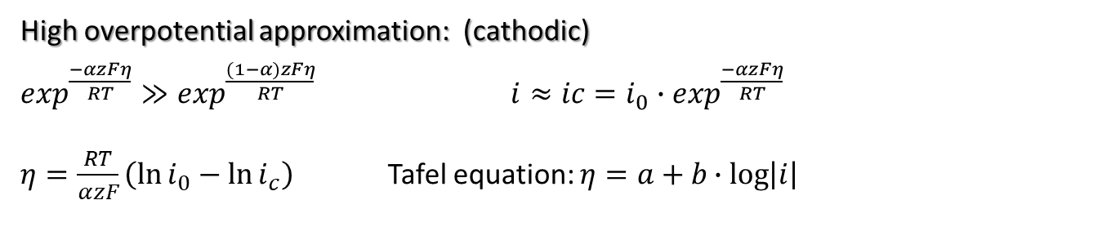
V) Electrodeposition mechanism and kinetics
1) Charge transfer: current-voltage relation
Low overpotential approximation:
$\frac{−αzFη}{RT}≪1$ → $\exp^{\frac{−αzFη}{RT}}≈1−\frac{−αzFη}{RT}$and $\frac{(1−α)zFη}{RT}≪1$ → $\exp^{\frac{(1−α)zFη}{RT}}≈1+\frac{(1−α)zFη}{RT}$
Linear approximation: $i=i_{0}∙\frac{zFη}{RT}$
High overpotential approximation: (cathodic)
$\exp^{\frac{−αzFη}{RT}}≫\exp^{\frac{(1−α)zFη}{RT}}$ $i≈ic=i_{0}∙\exp^{\frac{−αzFη}{RT}}$
$η=\frac{RT}{αzF}\left(\ln{i_{0}}−\ln{i_{c}}\right)$ Tafel equation: $η=a+b∙log\left|i\right|$
Out of equilibrium: $Δφ={Δφ}_{eq}+η$
$$i=i_{0}\left(\exp^{\frac{(1−α)zFη}{RT}}−\exp^{\frac{−αzFη}{RT}}\right)$$
Butler-Volmer equation

Slide 30
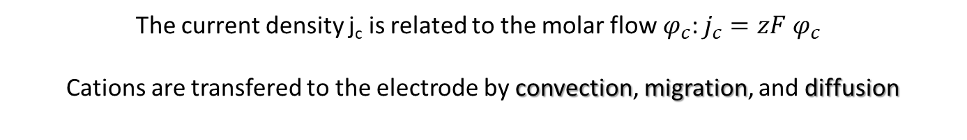
V) Electrodeposition mechanism and kinetics
2) Mass transfer limitation
The current density j_{c} is related to the molar flow$φ_{c}$: $j_{c}=zF$ $φ_{c}^{}$
Cations are transfered to the electrode by convection, migration, and diffusion

Slide 31
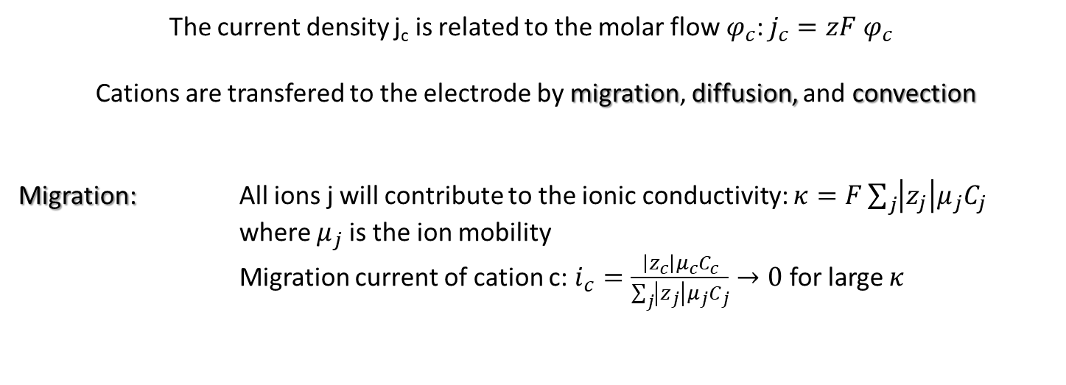
V) Electrodeposition mechanism and kinetics
2) Mass transfer limitation
The current density j_{c} is related to the molar flow$φ_{c}$: $j_{c}=zF$ $φ_{c}^{}$
Cations are transfered to the electrode by migration, diffusion, and convection
Migration: All ions j will contribute to the ionic conductivity: $κ=F\sum_{j}{\left|z_{j}\right|μ_{j}C_{j}}$
where $μ_{j}$is the ion mobility
Migration current of cation c: $i_{c}=\frac{\left|z_{c}\right|μ_{c}C_{c}}{\sum_{j}{\left|z_{j}\right|μ_{j}C_{j}}}→0$ for large $κ$

Slide 32
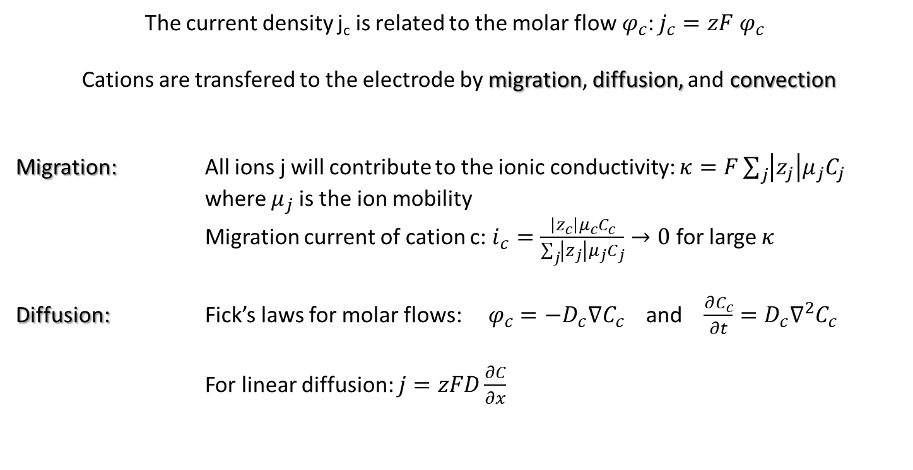
V) Electrodeposition mechanism and kinetics
2) Mass transfer limitation
The current density j_{c} is related to the molar flow$φ_{c}$: $j_{c}=zF$ $φ_{c}^{}$
Cations are transfered to the electrode by migration, diffusion, and convection
Migration: All ions j will contribute to the ionic conductivity: $κ=F\sum_{j}{\left|z_{j}\right|μ_{j}C_{j}}$
where $μ_{j}$is the ion mobility
Migration current of cation c: $i_{c}=\frac{\left|z_{c}\right|μ_{c}C_{c}}{\sum_{j}{\left|z_{j}\right|μ_{j}C_{j}}}→0$ for large $κ$
Diffusion: Fick’s laws for molar flows: $φ_{c}=−D_{c}∇C_{c}$ and $\frac{∂C_{c}}{∂t}=D_{c}∇^{2}C_{c}$
For linear diffusion: $j=zFD\frac{∂C}{∂x}$

Slide 33
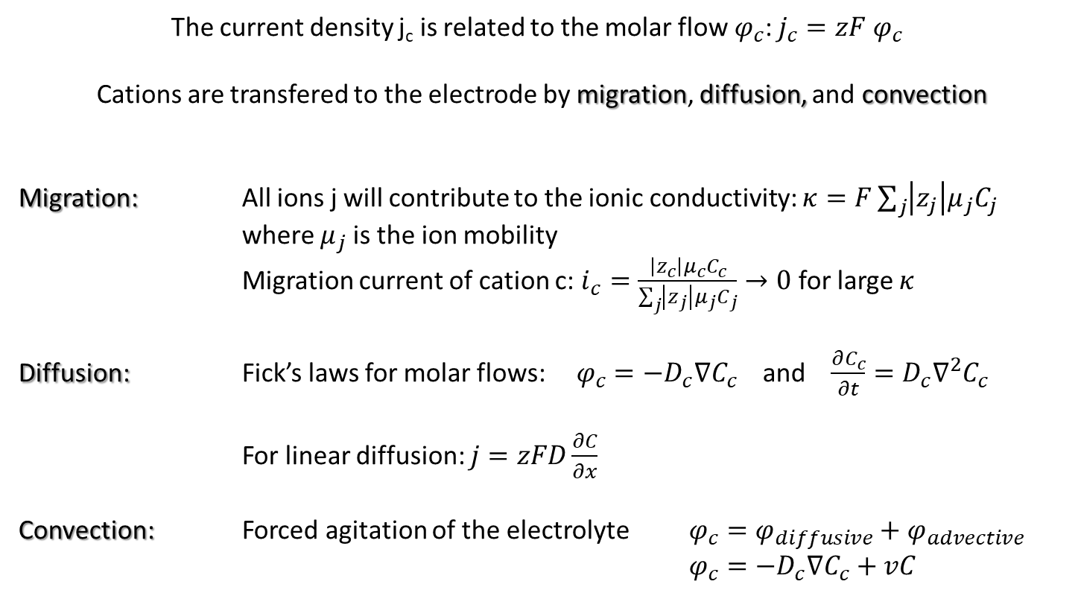
V) Electrodeposition mechanism and kinetics
2) Mass transfer limitation
The current density j_{c} is related to the molar flow$φ_{c}$: $j_{c}=zF$ $φ_{c}^{}$
Cations are transfered to the electrode by migration, diffusion, and convection
Migration: All ions j will contribute to the ionic conductivity: $κ=F\sum_{j}{\left|z_{j}\right|μ_{j}C_{j}}$
where $μ_{j}$is the ion mobility
Migration current of cation c: $i_{c}=\frac{\left|z_{c}\right|μ_{c}C_{c}}{\sum_{j}{\left|z_{j}\right|μ_{j}C_{j}}}→0$ for large $κ$
Diffusion: Fick’s laws for molar flows: $φ_{c}=−D_{c}∇C_{c}$ and $\frac{∂C_{c}}{∂t}=D_{c}∇^{2}C_{c}$
For linear diffusion: $j=zFD\frac{∂C}{∂x}$
Convection: Forced agitation of the electrolyte $φ_{c}=φ_{diffusive}+φ_{advective}$
$φ_{c}=−D_{c}∇C_{c}+vC$

Slide 34
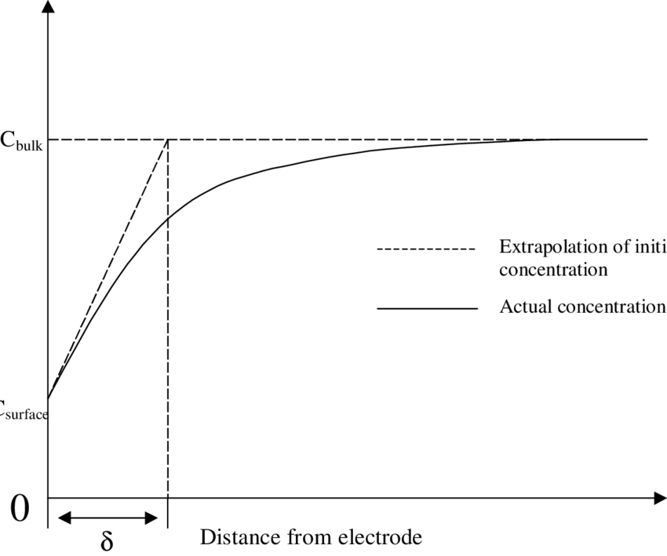

V) Electrodeposition mechanism and kinetics
2) Mass transfer limitation
Nernst diffusion layer for a planar electrode
$$j=zFD\frac{C^{sol}−C^{el}}{δ}$$

Slide 35

V) Electrodeposition mechanism and kinetics
2) Mass transfer limitation
Nernst diffusion layer for a planar electrode
t increases
$$j=zFD\frac{C^{sol}−C^{el}}{δ}$$
High overpotentials → $C^{el}→0$
Solution to Fick’s second law: $δ=\sqrt{πDt}$
Cottrell law: $j_{lim}=zFC^{sol}\sqrt{\frac{D}{πt}}$

Slide 36
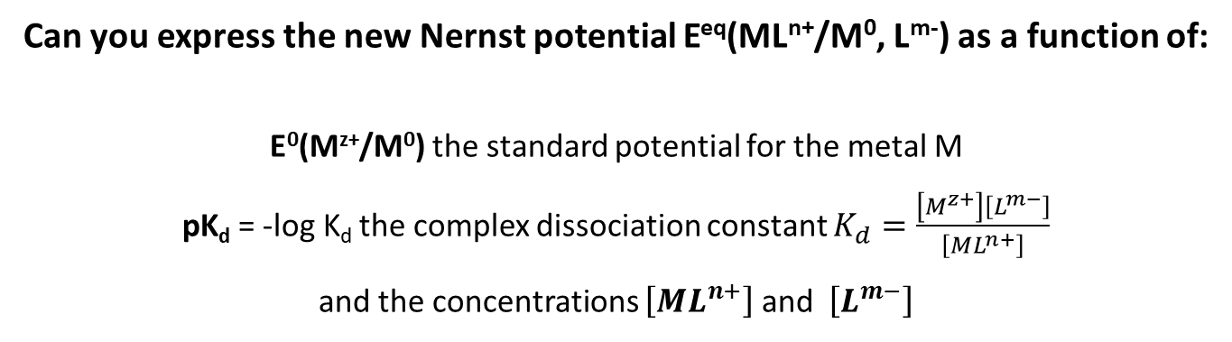
V) Electrodeposition mechanism and kinetics
3) Chemical-electrochemical reactions
Example: reduction of a metalorganic complex [ML_{x}]^{z+}
1) [ML_{x}]^{n+} → M^{z+} + xL^{m-} complexation constant independent of potential
2) M^{z+} + ze⁻ → M⁰ the slower process defines the reaction kinetics
Can you express the new Nernst potential E^{eq}(ML^{n+}/M⁰, L^{m-}) as a function of:
E⁰(M^{z+}/M⁰) the standard potential for the metal M
pK_{d} = -log K_{d} the complex dissociation constant $K_{d}=\frac{\left[M^{z+}\right]\left[L^{m−}\right]}{\left[{ML}^{n+}\right]}$
and the concentrations $\left[{ML}^{n+}\right]$ and $\left[L^{m−}\right]$

Slide 37
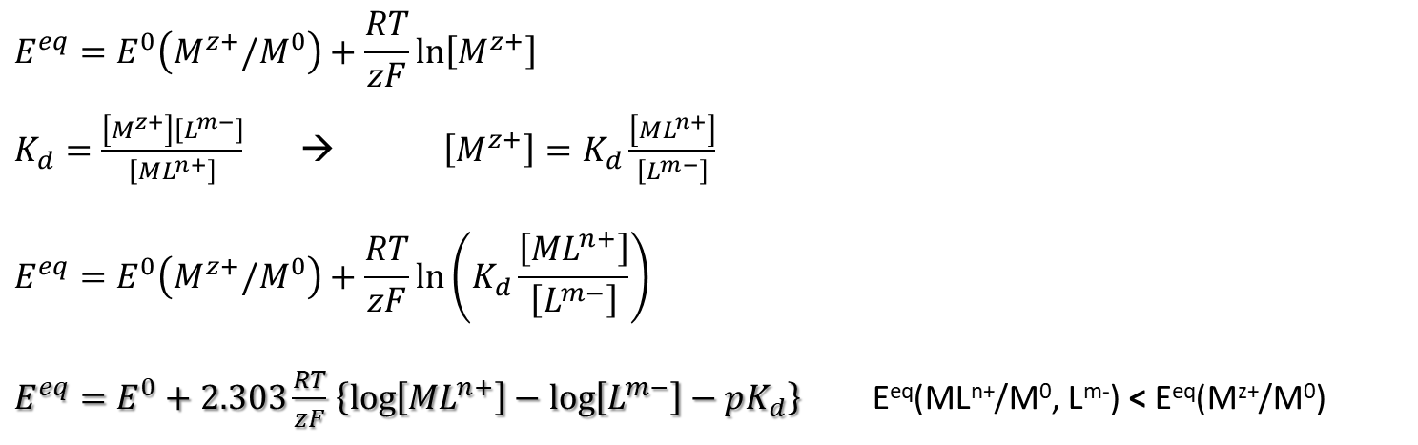
V) Electrodeposition mechanism and kinetics
3) Chemical-electrochemical reactions
Example: reduction of a metalorganic complex [ML_{x}]^{z+}
1) [ML_{x}]^{n+} → M^{z+} + xL^{m-} complexation constant independent of potential
2) M^{z+} + ze⁻ → M⁰ the slower process defines the reaction kinetics
$$E^{eq}=E^{0}\left(M^{z+}/M^{0}\right)+\frac{RT}{zF}\ln\left[M^{z+}\right]$$
$K_{d}=\frac{\left[M^{z+}\right]\left[L^{m−}\right]}{\left[{ML}^{n+}\right]}$ → $\left[M^{z+}\right]=K_{d}\frac{\left[{ML}^{n+}\right]}{\left[L^{m−}\right]}$
$$E^{eq}=E^{0}\left(M^{z+}/M^{0}\right)+\frac{RT}{zF}\ln\left(K_{d}\frac{\left[{ML}^{n+}\right]}{\left[L^{m−}\right]}\right)$$
$E^{eq}=E^{0}+2.303\frac{RT}{zF}$ $\left\{\log\left[{ML}^{n+}\right]−\log\left[L^{m−}\right]−pK_{d}\right\}$ E^{eq}(ML^{n+}/M⁰, L^{m-}) < E^{eq}(M^{z+}/M⁰)

Slide 38
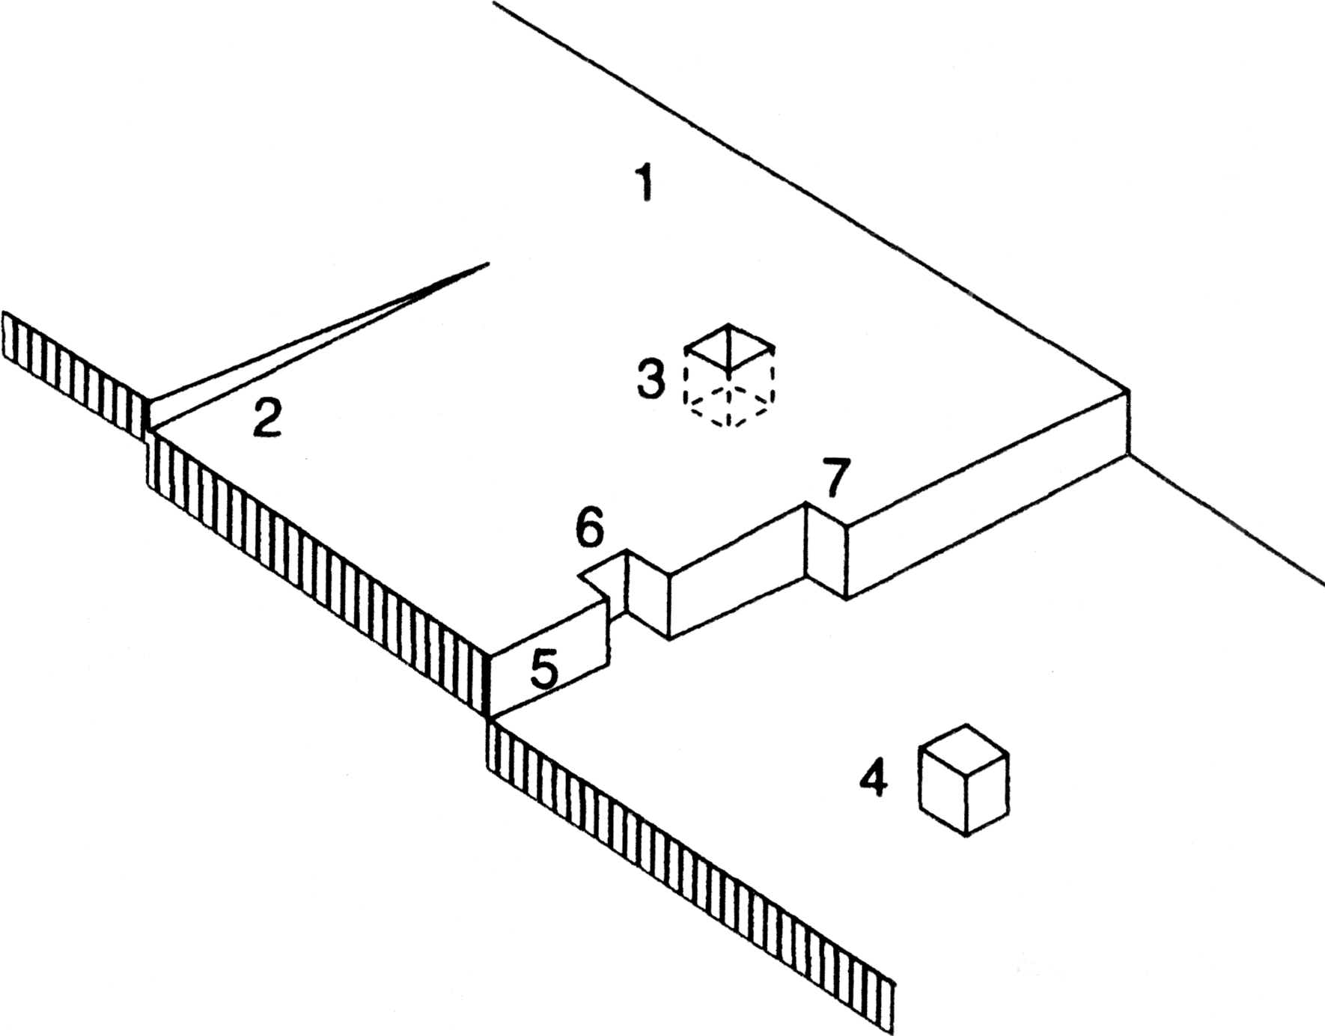
V) Electrodeposition mechanism and kinetics
4) Adion diffusion and electrocrystallisation
Real surfaces are not ideal surfaces
Density of metal surface atoms 10¹⁵ cm⁻²
Density of dislocations 10⁴ – 10⁸ cm⁻²
Perfect flat surface,terrace Emerging screw dislocation Vacancy in a terrace Adatom in a terrace
A ledge: (mono)atomic step
Vacancy in the ledge
Kink: a ledge in the ledge
Simple defects

Slide 39
V) Electrodeposition mechanism and kinetics
4) Adion diffusion and crystallisation
Bockris (1958):
The activation energy depends on surface site
$${ΔG}_{e,3}^{∗}<{ΔG}_{e,6}^{∗}<{ΔG}_{e,7}^{∗}<{ΔG}_{e,5 }^{∗}≾{ΔG}_{e,2}^{∗}≾{ΔG}_{e,4}^{∗}<{ΔG}_{e,1}^{∗}$$
Perfect flat face,terrace Emerging screw dislocation Vacancy in the terrace Adatom in the terrace
A ledge: monoatomic step
Vacancy in the ledge
Kink: a ledge in the ledge
Simple defects

Slide 40
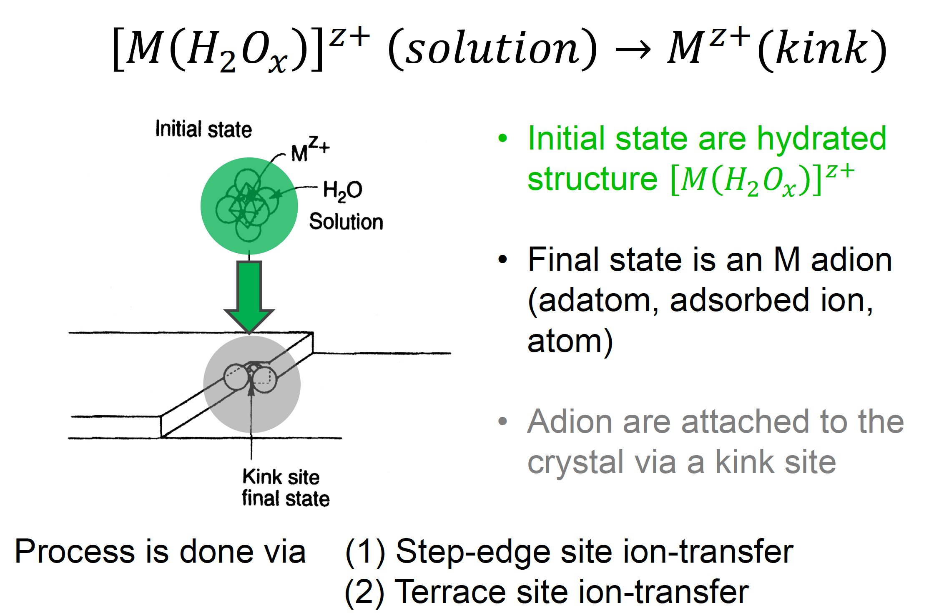
V) Electrodeposition mechanism and kinetics
4) Adion diffusion and crystallisation

Slide 41
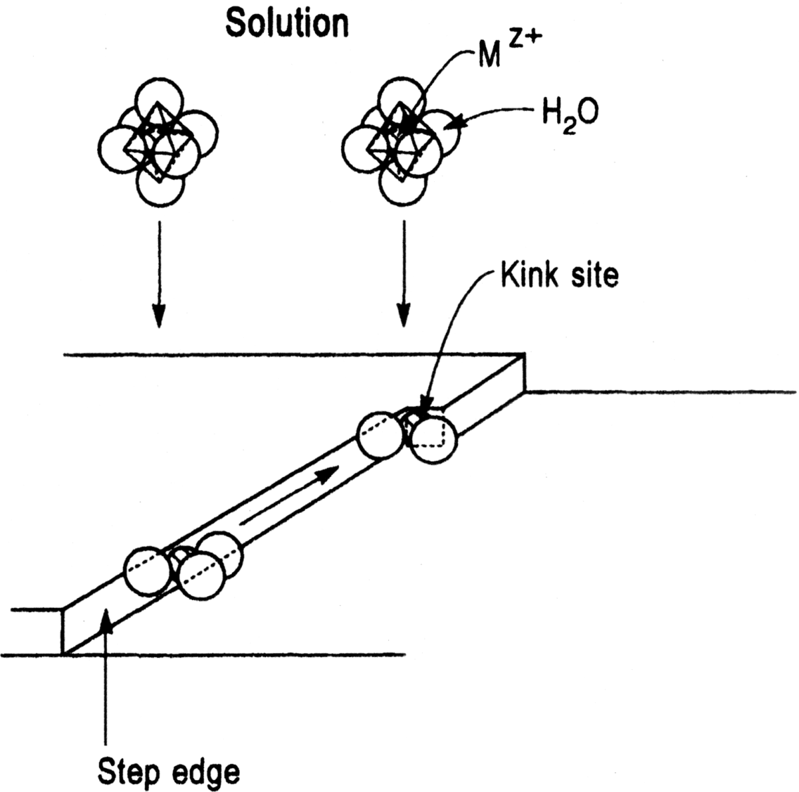
V) Electrodeposition mechanism and kinetics
4) Adion diffusion and crystallisation
Direct transfer to the kink
Indirect transfer to the step- edge site other than a kink, the transfered metal ion diffuses along the step edge until it finds a kink

Slide 42
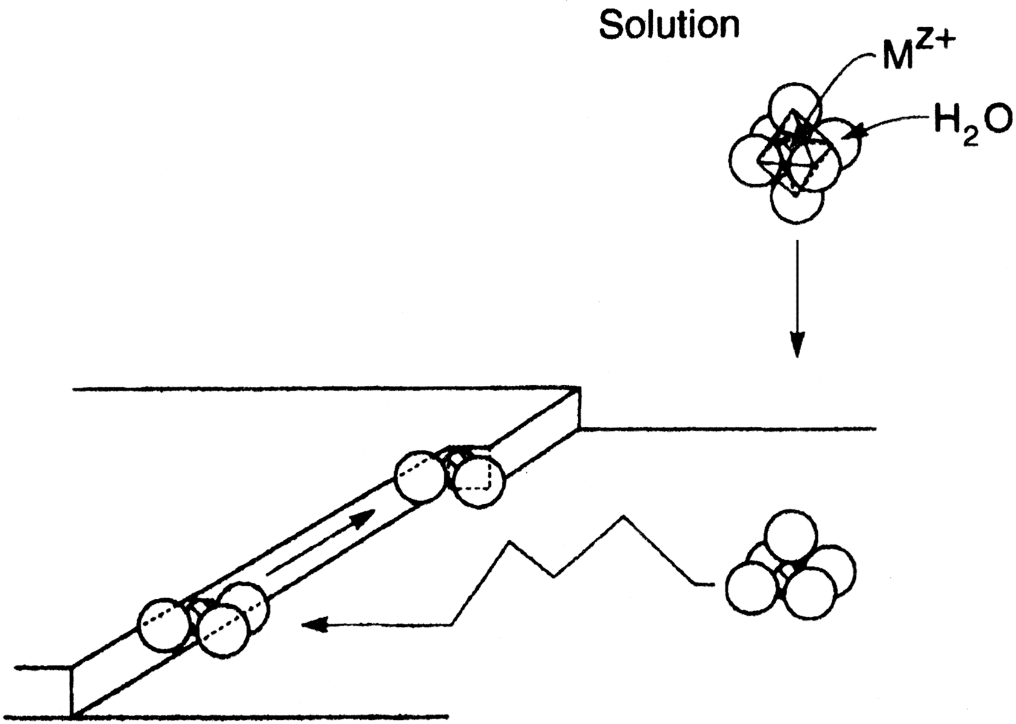
V) Electrodeposition mechanism and kinetics
4) Adion diffusion and crystallisation
Metal ion transferred from solution to the flat face of terrace region
From this position, diffuses on the surface, seeking a position of lower energy
Final position is a kink site

Slide 43
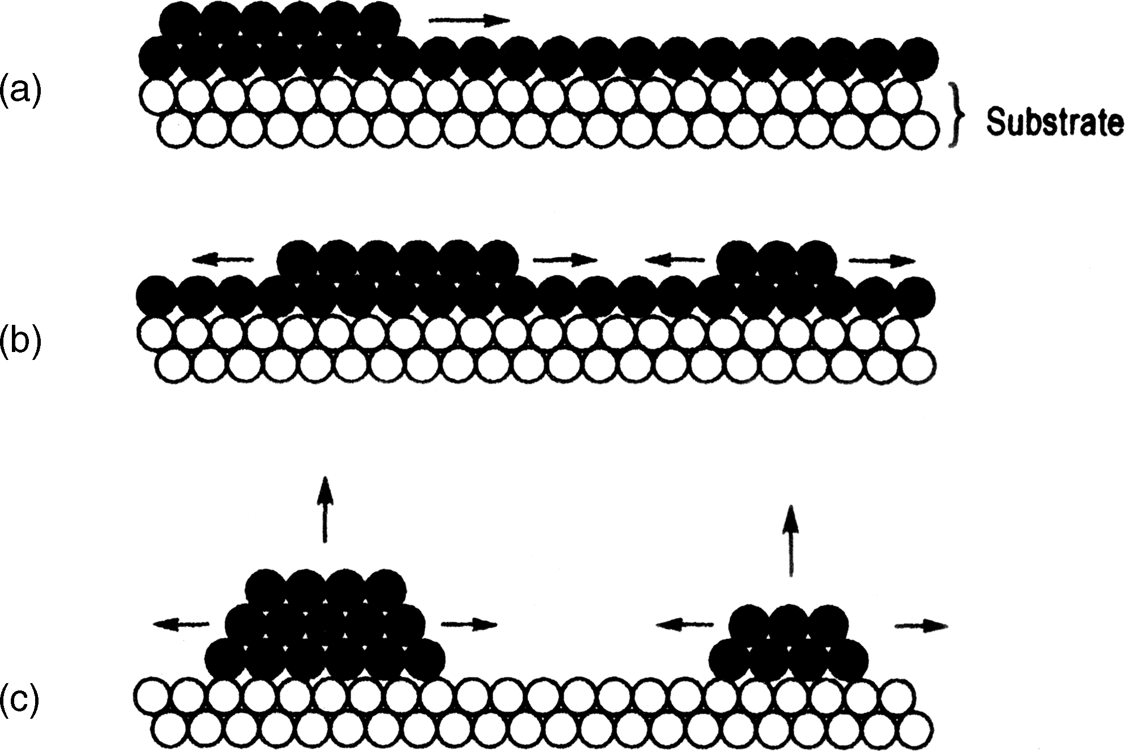
V) Electrodeposition mechanism and kinetics
5) Nucleation and growth
Nucleation sites = defects on the electrode surface
Two nucleation regimes: progressive or instantaneous
Two growth modes: 2D or 3D
Layer by layer growth (2D)
3D growth of nuclei

Slide 44
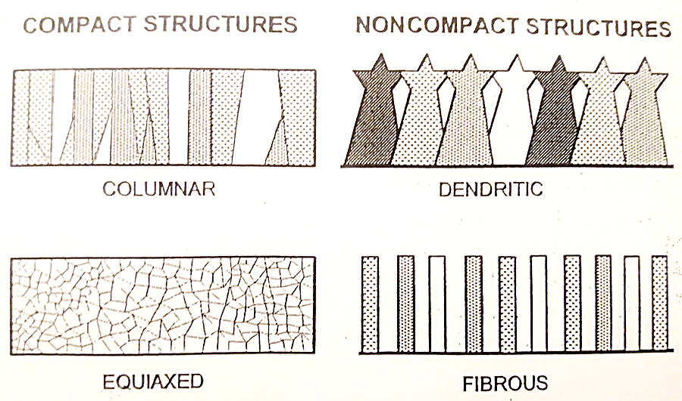
V) Electrodeposition mechanism and kinetics
5) Nucleation and growth
Competition between nucleation and growth processes is strongly influenced by the electrodeposition kinetics
Nucleation and growth modes and the effect of electrodeposition parameters will be described in the next chapter.
44

